Slide 1
Federated activities to support the
geophysical validation of
TEMPO L2/L3 products
Jim Szykman, Russell Long, Jay Al-Saadi,
Jim Crawford, Dave Flittner, and
Kevin Cavender
May 27-28, 2015
3rd TEMPO Science Team Meeting
UAH-NSSTC
Huntsville, AL

Slide 2
Proposed Approach for validation (presented at 1st STM)
Validation conducted from commissioning till end of Phase E (12 months to ???).
Level | Product Definition | GB/day | Approach | Initial release
0 | Raw instr. Sci. and HK data | 63 | Quality flags for duplicates, missing files, checksums | C+30
1b | Level 1 geo-located, calibrated spectral radiances | 26 | Comparisons with measured and modeled radiances based on coincident column measurements | C+60
2 | Retrieved gas columns and profiles, aerosol, clouds, UVB | 34 | Comparisons with ground-based, balloon-borne, sub-orbital, and satellite remote-sensed products | C+120
2 NRT | Retrieved gas, aerosols, clouds, UVB | 16 | Comparison with L2 normal delivery products | C+120
3† | Gridded monthly means of L2 data | 3 | Comp. with correlative measurements and climatologies | C+120

Slide 3
Rationale for pursuit of a Federated Activity for TEMPO L2/L3 Validation
A federated approach to validation/evaluation of L2/L3 geophysical variables using existing air quality network infrastructure could help promote early acceptance of L2/L3 data products, especially given the potential short operational life of TEMPO.
Current proposed changes by the EPA to the existing Photochemical Assessment Monitoring Station (PAMS) Network provides a unique opportunity to:
Leverage existing/expanding infrastructure already required and funded by EPA via the Clean Air Act.
Develop continuous (24/7) TEMPO correlative data validation sites in the areas with the worst O₃ pollution.
Help foster more significant interaction between TEMPO science team and the air quality agencies.
Build on existing AQ long term datasets in urban areas, and make TEMPO data products more relevant to air quality managers.

Slide 4
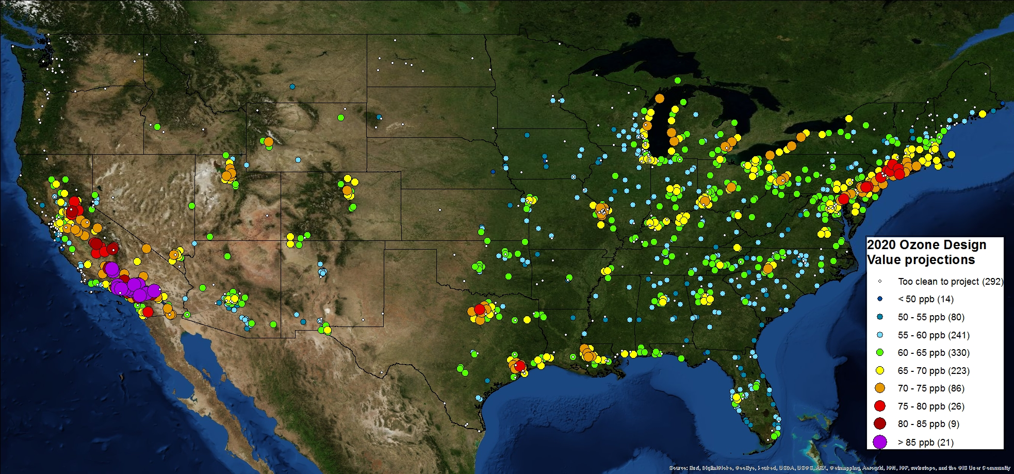
A TEMPO relevant projection
O₃ 8-hour Design Value Projections to 2020

Slide 5
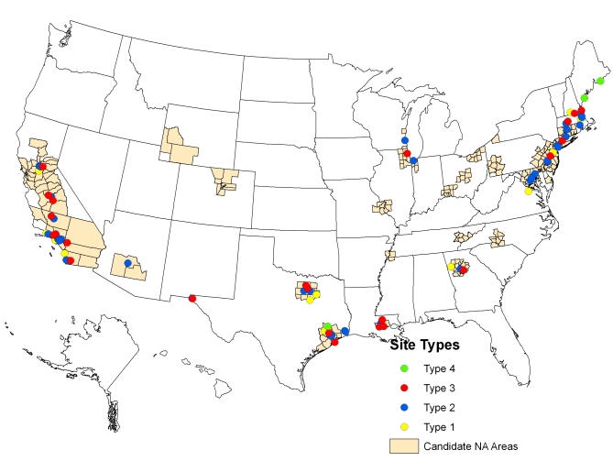
Development of a Federated Set of Ground Validation Sites
EPA Photochemical Assessment Monitoring Station (PAMS) program was Established as a result of 1990 Clean Air Act Amendments (CAAA) to collect measurements in areas classified as serious, severe, or extreme ozone nonattainment.
-The overall objective of PAMS network is to provide measurements that will assist States in understanding ozone nonattainment problems and to implement strategies to solve the problem.
-The PAMS network sites are operated by the state and local air pollution agency – not EPA.
Existing Locations for
PAMS Network

Slide 6
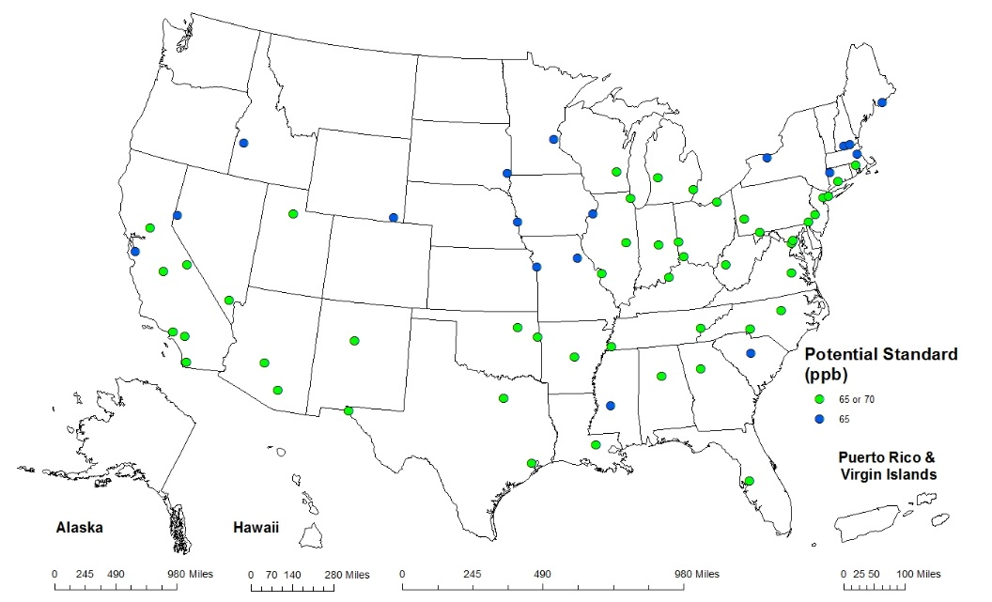
Development of a Federated Set of Ground Validation Sites
Forthcoming changes in air quality monitoring requirements under the Photochemical Assessment Monitoring Station (PAMS) program by EPA present an opportunity to aid with TEMPO validation/evaluation.
Combines Ncore and PAMS Measurements:
NO, NO₂, NO_{y}, O₃ (year round). SO₂, CO, PM_{2.5} mass and speciation (At least 1-in-3 day), PM_{2.5} continuous, PM_{10-2.5} mass, basic met. parameters.
Profiling Measurements: Continue use of existing Radar wind profiler (RWP)/Radio acoustic sounding system (RASS) supplemented with use of ceilometer at new sites for continuous mixing heights.
Some site contain optional met measurements – Vertical wind speed, solar radiation, precipitation, baro. pressure, delta-T for 2-10m.
Option to add continuous CH₂O in the future as reliable commercial units are become available.
Potential New Locations for
PAMS Network
Map based on 2011-2013 ozone design values
PAMS requirements will be based on 2014-2016 data

Slide 7
Schedule for changes under PAMS Network Re-Engineering
-Proposed PAMS changes included as part of the ozone NAAQS proposal, signed on November 25, 2014
-Final regulatory changes to be part of the final ozone NAAQS package expected to be signed by October 1, 2015
-EPA is planning a staggered deployment to allow time for monitoring agencies to buy new equipment (autoGCs, true NO₂ analyzers, and ceilometers) and to train staff and develop SOPs and QAPPs
-October 2017 earliest anyone would likely need to comply – likely staggering deadlines through 2019 based on designations schedule for new O₃ standard.

Slide 8
TEMPO relevant changes under PAMS Network Re-Engineering
Required PAMS
Issue: Standard NOx measurement technology is known to have positive interferences from other non-NOx species (HNO₃, PAN, etc.) and does not measurement NO₂ directly.
Proposed Solution: Add a “true NO2” measurement at required PAMS-NCore sites.
Issue: Formaldehyde (CH₂O) is now recognized as one of the most important ozone precursors
Proposed solution: Restart carbonyl measurements which includes CH₂O, still not very useful for TEMPO. Option to add commercial CH₂O measurements methods for high time low detection limit (ppb).
Issue: Existing radar profilers with RASS temperature profilers at PAMS sites are old and in need of replacement or expensive upgrades.
Proposed solution: Addition of ceilometers to provide continuous mixing height via aerosol backscatter (910 nm). Can also provide aerosol layer heights and cloud heights up to 15+ km.

Slide 9
Development of a Federated Set of Ground Validation Sites
The addition of Pandora and Cimel Instruments to a subset of new Ncore/PAMS sites would add critical measurements to form a network of TEMPO validation/evaluation sites.
Combines Ncore and PAMS Measurements:
NO, NO₂, NO_{y}, O₃ (year round). SO₂, CO, PM_{2.5} mass and speciation (At least 1-in-3 day), PM_{2.5} continuous, PM_{10-2.5} mass, basic met. parameters.
Profiling Measurements: Continue use of existing Radar wind profiler (RWP)/Radio acoustic sounding system (RASS) supplemented with use of ceilometer at new sites for continuous mixing heights.
Some site contain optional met measurements – Vertical wind speed, solar radiation, precipitation, baro. pressure, delta-T for 2-10m.
Option to add continuous CH₂O in the future as reliable commercial units are become available.
Potential New Locations for
PAMS Network
Map based on 2011-2013 ozone design values
PAMS requirements will be based on 2014-2016 data

Slide 10
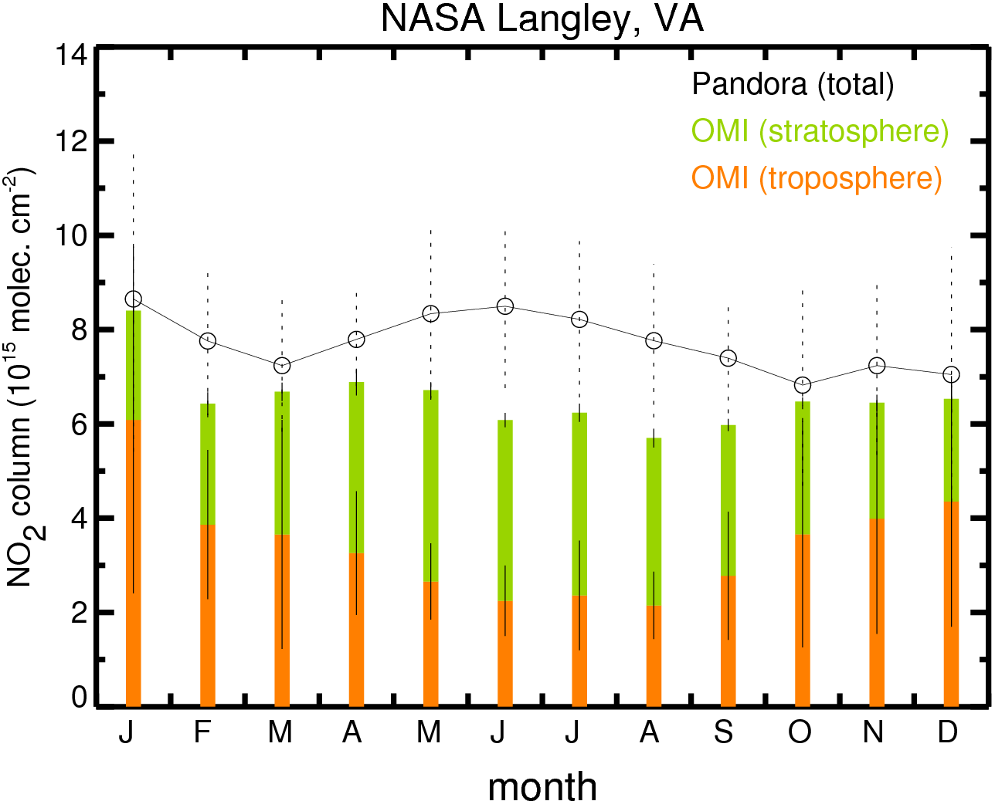
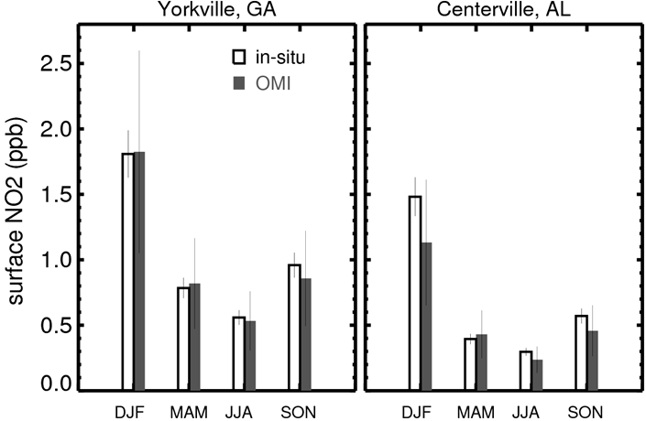
OMI use of long-term existing ground-based measurements
Monthly variation of total NO2 columns at Hampton, VA for 2009-2012, as calculated from Pandora measurements (line with open circles) and OMI measurements (bars).
Seasonal variation of NO2 mixing ratios at rural SEARCH sites for 2006-2010.
Lamsal et al., ACP 2014

Slide 11
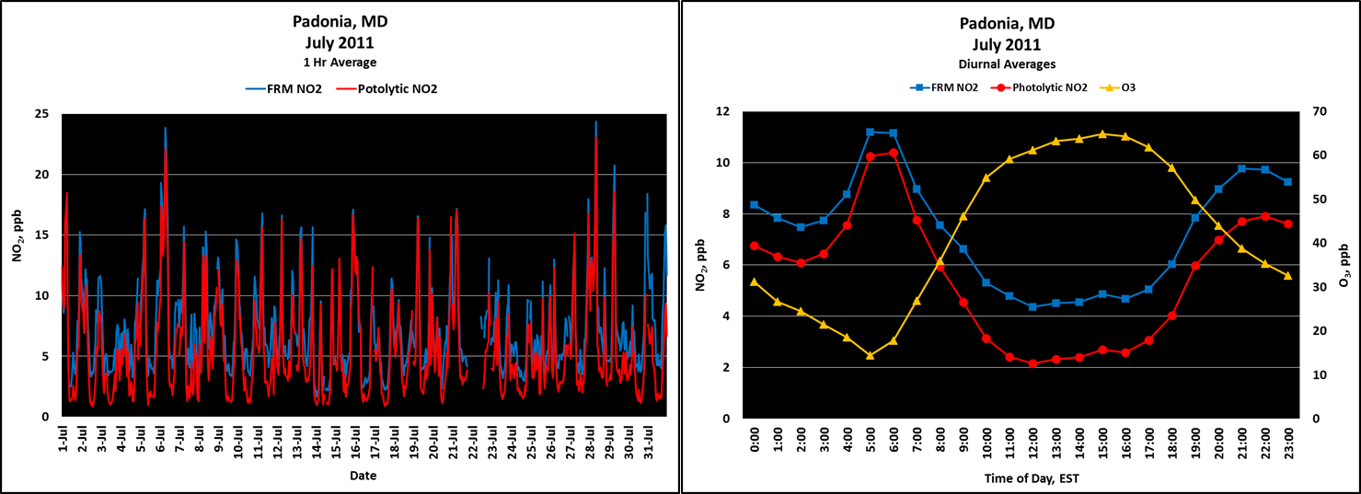
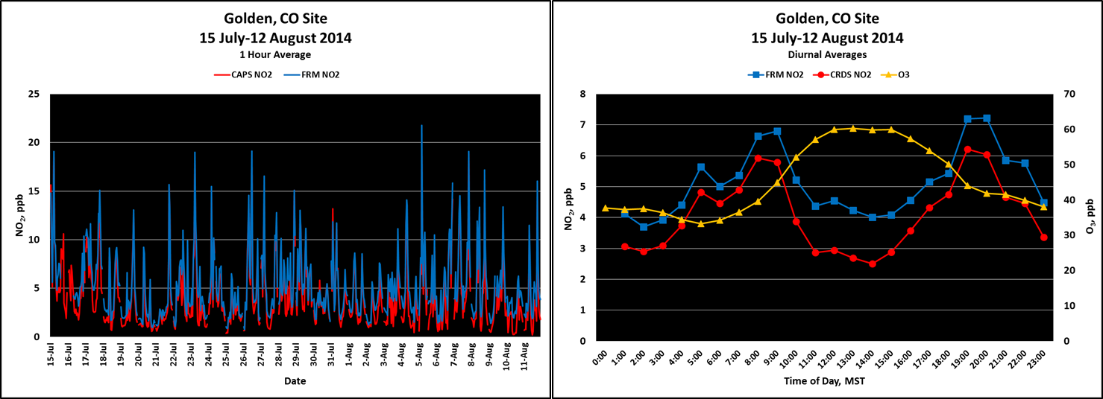
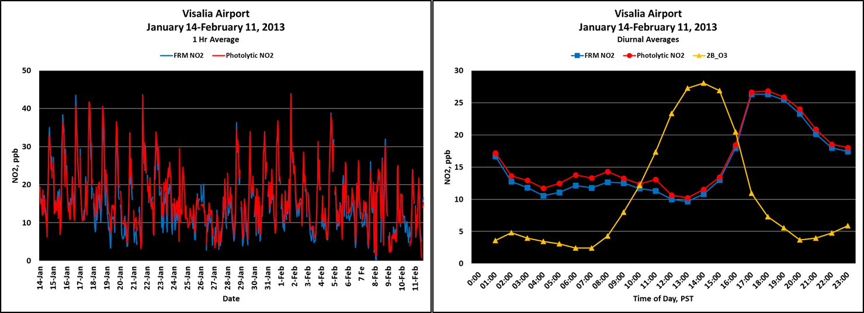
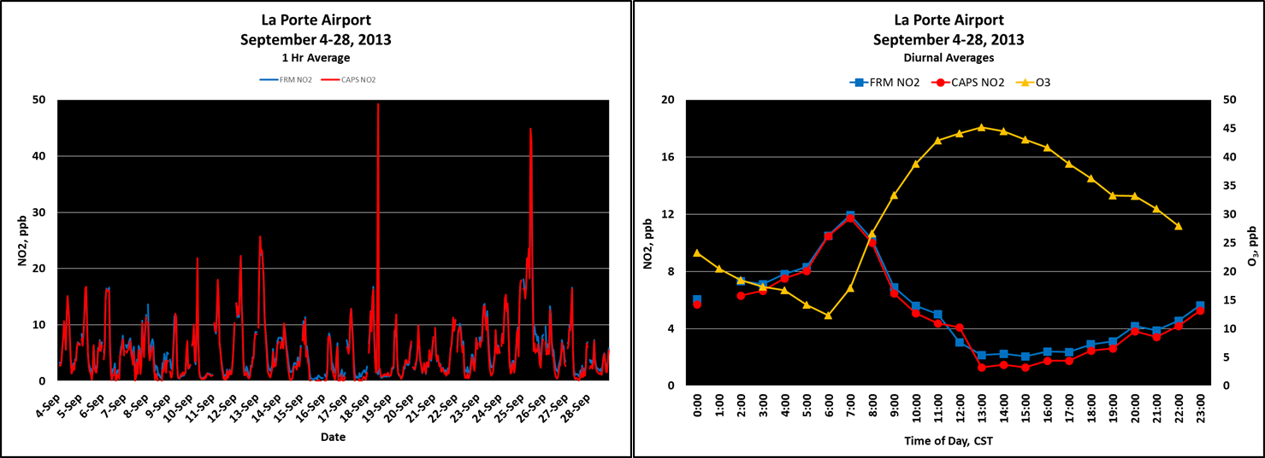
DISCOVER-AQ Comparison of NO₂ Measurements FRM vs Optical/Photolytic
Photochemistry Dominated
NO₂ measured by the conventional FRM (Moly converter-chemiluminescence) is overestimated by as much as 50% as compared to more selective (optical, photolytic) NO₂ methods during peak photochemistry hours at sites (Padonia, Golden) that are not dominated by persistent nearby sources.
Fresh Emissions Dominated
At near source sites (Visalia Airport, La Porte Airport) better agreement is obtained between the FRM and optical/photolytic NO₂ methods.

Slide 12
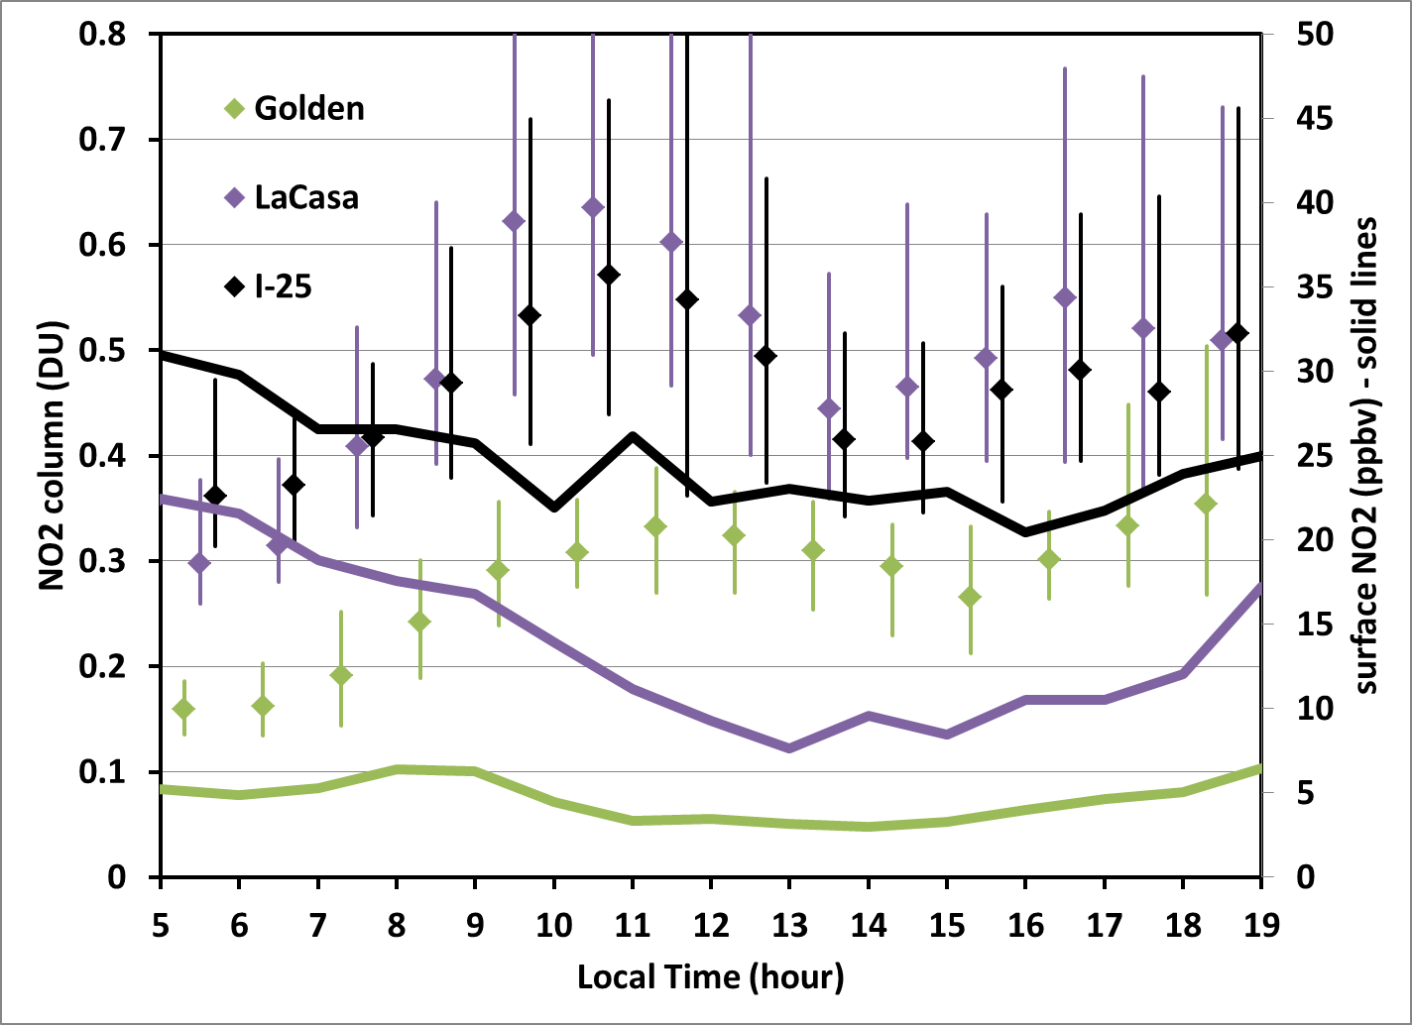
Pandora vs Surface-Colorado

Slide 13
Relevant measurements for L2/L3 Geophysical Validation from a Federated Ground Network
Development of a federated correlative validation data sets would allow for:
A long-term statistical analysis and for comparisons under differing atmospheric and viewing conditions. Desirable attributes of the proposed correlative data set are;
Accuracy: well-validated measurements,
Temporal coverage: e.g., comparisons with fixed sites for seasonal and longer-term studies, and,
Numerous sites over the U.S. with the potential for local technical support.
TEMPO Data Products:
Ozone
Total Ozone Column - UV/VIS Spectrometer PANDORA
Tropospheric Ozone - in-situ surface O3
NO2
Total Nitrogen Dioxide Column - UV/VIS Spectrometer PANDORA
Tropospheric Nitrogen Dioxide -UV/VIS Spectrometer PANDORA, ceilometer, and in-situ surface NO2
SO2
Total Sulfur Dioxide Column - UV/VIS Spectrometer PANDORA and in-situ surface SO2 at CAPABLE and AIRS
Aerosol loading and optical properties in the UV - AERONet Cimel and aerosol height via ceilometer (920 nm)
CH₂O
Total Formaldehyde Columns - UV/VIS Spectrometer PANDORA, in-situ surface CH₂O (likely available at limited number of sites), and aerosol height via ceilometer (920 nm)

Slide 14
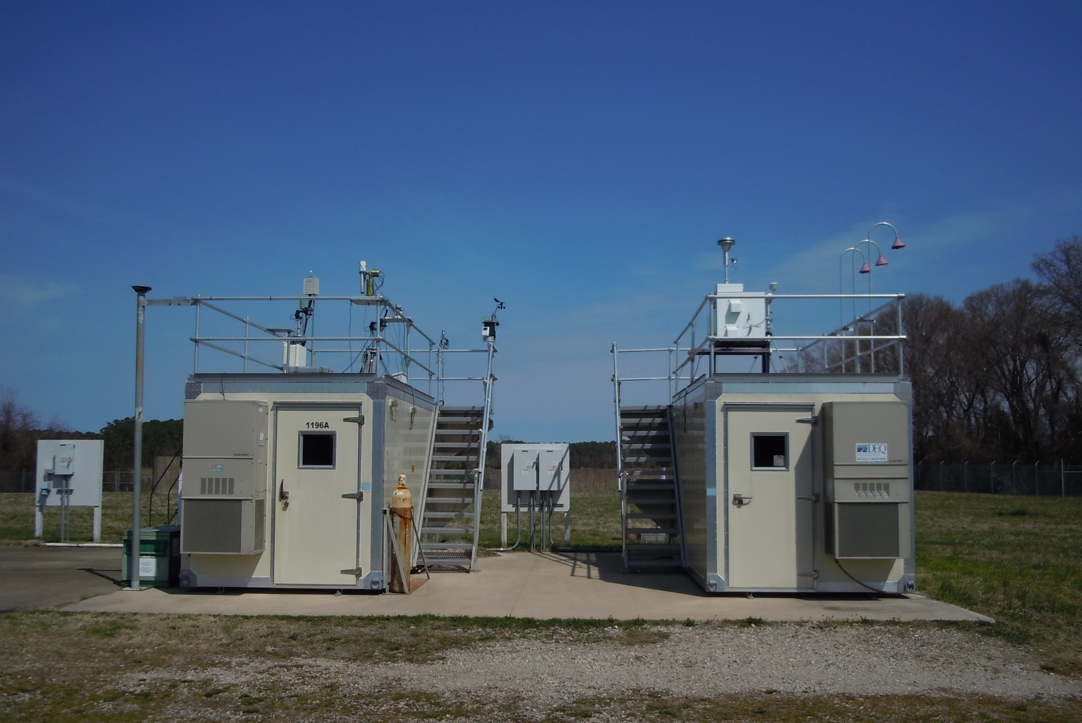
Prototype Instrument Suite for Ground Validation Sites
EPA gas sample inlet for NO, NO2, and O3 and NOy
VADEQ gas sample inlet for SO2, O3, NOx, and CO
NASA AERONet cimel
Pandora UV/VIS Spectrometers
NASA-EPA
Shelter
VADEQ
Shelter
EPA CL-51 ceilometer
(mixing heights)
Office ofi Research and Development
National Exposure Research Laboratory

